Slide 1
Digital Image processing 10
Dep. of Computer Science & Information Engineering, Asia University
Associate Professor
Rung-Sheng Chen

Slide 2
installation Pytorch
Step 1 — Knowing The Dataset

Slide 3
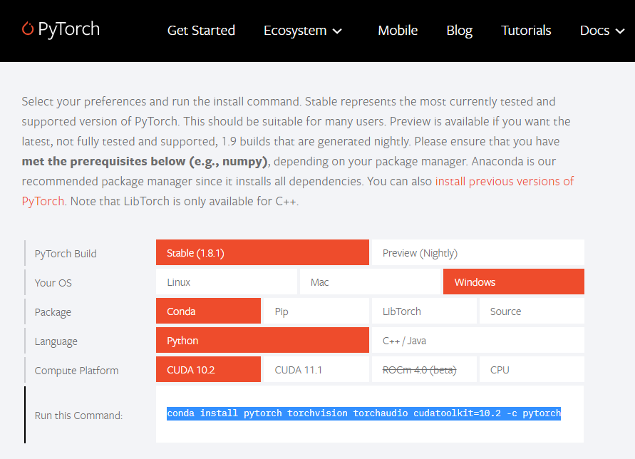
https://pytorch.org/[1]

Slide 4
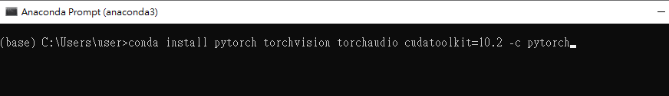

Slide 5
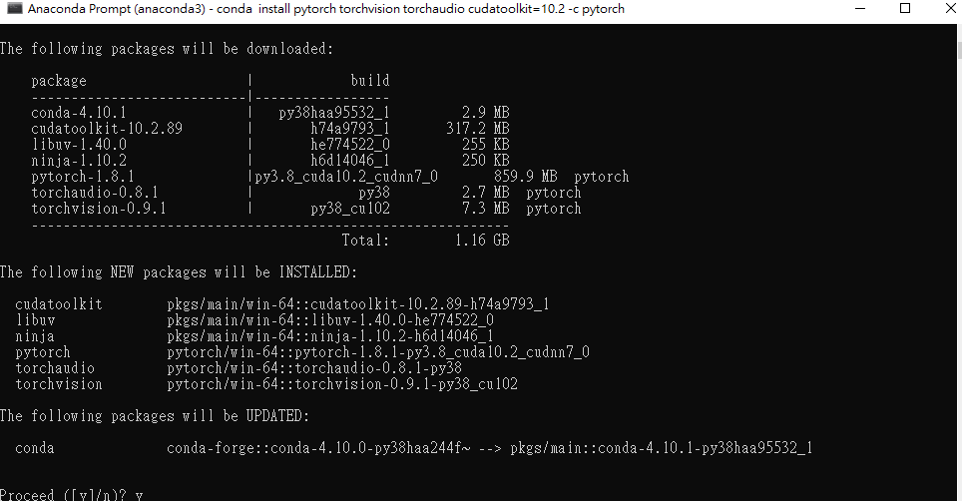

Slide 6
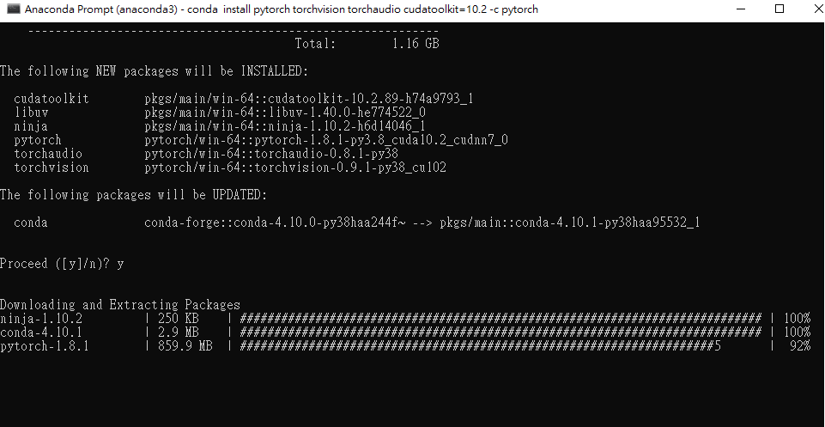
Install pytorch
It takes about 20-25 mins.

Slide 7
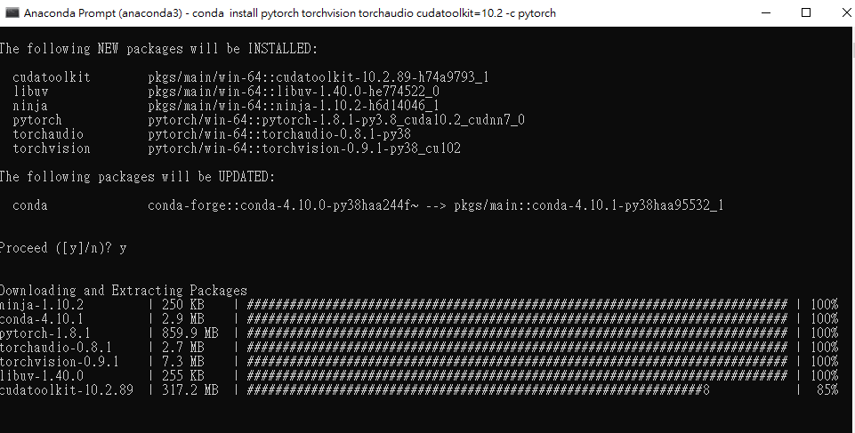
Install cuda

Slide 8
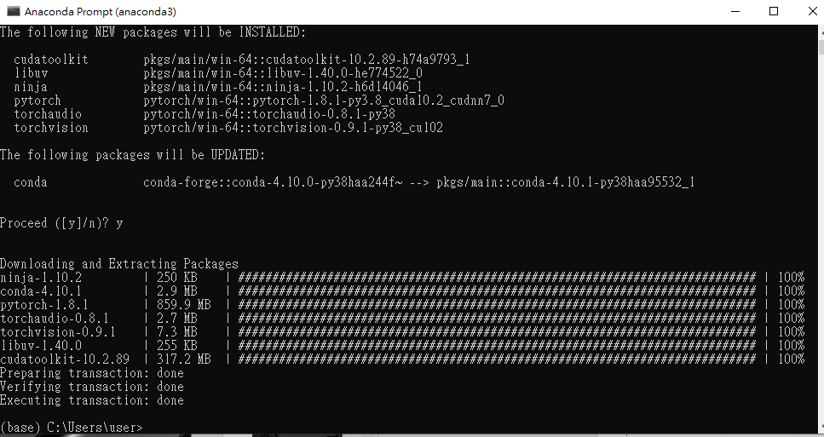
It takes about 30-40 mins.

Slide 9
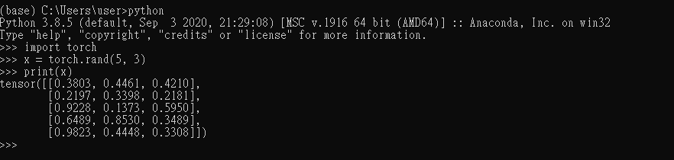
verification
To ensure that PyTorch was installed correctly, we can verify the installation by running sample PyTorch code. Here we will construct a randomly initialized tensor.
From the command line, type:
python,
Then type
import torch
x = torch.rand(5, 3)
print(x)
The output should be something similar to:

Slide 10

Additionally, to check if your GPU driver and CUDA is enabled and accessible by PyTorch, run the following commands to return whether or not the CUDA driver is enabled:
import torch
torch.cuda.is_available()

Slide 11
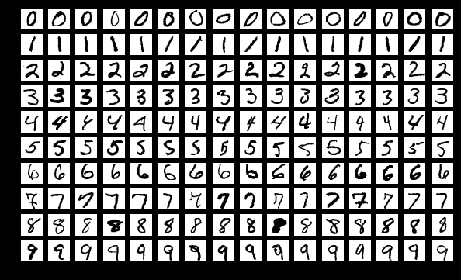
Step 1 — Knowing The Dataset
The most crucial task as a Data Scientist is to gather the perfect dataset and to understand it thoroughly. Trust me, the rest is a lot easier. For this project, we will be using the popular MNIST database. It is a collection of 70000 handwritten digits split into training and test set of 60000 and 10000 images respectively.
Source: Wikimedia

Slide 12
The data set is originally available on Yann Lecun’s website. Cleaning the data is one of the biggest tasks. Don’t forget — “Garbage in, garbage out !”. Luckily, for us PyTorch provides an easy implementation to download the cleaned and already prepared data, using a few lines of code. Before starting, we need to make all the necessary imports.
import numpy as np import torch import torchvision import matplotlib.pyplot as plt from time import time from torchvision import datasets, transforms from torch import nn, optim

Slide 13
define what are the transformations we want to perform
【transform=transforms.Compose([transforms.ToTensor(),transforms.Normalize((0.5,), (0.5,)),])】
1.transforms.ToTensor() — converts the image into numbers, that are understandable by the system. It separates the image into three color channels (separate images): red, green & blue. Then it converts the pixels of each image to the brightness of their color between 0 and 255. These values are then scaled down to a range between 0 and 1. The image is now a Torch Tensor.

Slide 14
【transform=transforms.Compose([transforms.ToTensor(),transforms.Normalize((0.5,), (0.5,)),])】
2.transforms.Normalize() — normalizes the tensor with a mean and standard deviation which goes as the two parameters respectively.

Slide 15
download the data sets
download the data sets, shuffle them and transform each of them. We download the data sets and load them to DataLoader, which combines the data-set and a sampler and provides single- or multi-process iterators over the data-set.
【trainset = datasets.MNIST('PATH_TO_STORE_TRAINSET', download=True, train=True, transform=transform)
valset = datasets.MNIST('PATH_TO_STORE_TESTSET', download=True, train=False, transform=transform)
trainloader = torch.utils.data.DataLoader(trainset, batch_size=64, shuffle=True)
valloader = torch.utils.data.DataLoader(valset, batch_size=64, shuffle=True)】
In one line, batch size is the number of images we want to read in one go.

Slide 16
Step 2 — Knowing The Dataset Better
In this phase, we will be doing some exploratory data analysis on our images and tensors. Let us check out the shape of the images and the labels.
【dataiter = iter(trainloader)
images, labels = dataiter.next()
print(images.shape)
print(labels.shape)】

Slide 17

The shape of images as you’ll find out is, torch.Size([64,1,28,28]), which suggests that there are 64 images in each batch and each image has a dimension of 28 x 28 pixels. Similarly, the labels have a shape as torch.Size([64]). Guess why? — Yes, you’re right! 64 images should have 64 labels respectively. That’s it. Easy!

Slide 18
Let’s display one image from the training set, for example, the first one.
【plt.imshow(images[3].numpy().squeeze(), cmap='gray_r')】

Slide 19
Let’s display some more images, this will give us a feel of how the dataset looks like.
【figure = plt.figure()
num_of_images = 60
for index in range(1, num_of_images + 1):
plt.subplot(6, 10, index)
plt.axis('off')
plt.imshow(images[index].numpy().squeeze(), cmap='gray_r')】

Slide 21
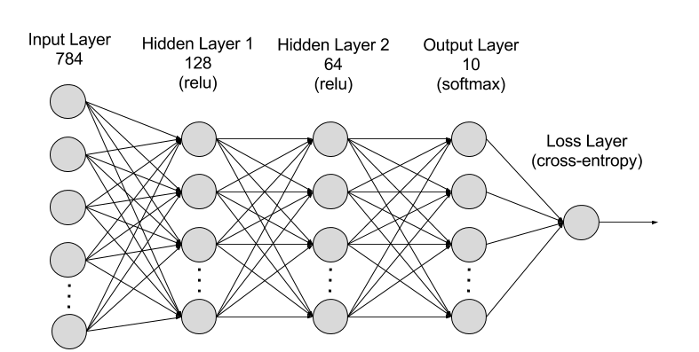
Step 3 — Build The Neural Network
We will be building the following network, as you can see it contains an input layer (the first layer), an output layer of ten neurons (or units, the circles) and two hidden layers in between.

Slide 22

PyTorch’s torch.nn module allows us to build the above network very simply. It is extremely easy to understand as well. Look at the code below.
【input_size = 784
hidden_sizes = [128, 64]
output_size = 10
model = nn.Sequential(nn.Linear(input_size, hidden_sizes[0]),
nn.ReLU(),
nn.Linear(hidden_sizes[0], hidden_sizes[1]),
nn.ReLU(),
nn.Linear(hidden_sizes[1], output_size),
nn.LogSoftmax(dim=1))
print(model)】

Slide 23
you must be wondering why do we have 784 units in the first layer. Good! It is because we flatten out each image before sending it inside the neural network. (28 x 28 = 784)

Slide 24
【input_size = 784
hidden_sizes = [128, 64]
output_size = 10
model = nn.Sequential(nn.Linear(input_size, hidden_sizes[0]),
nn.ReLU(),
nn.Linear(hidden_sizes[0], hidden_sizes[1]),
nn.ReLU(),
nn.Linear(hidden_sizes[1], output_size),
nn.LogSoftmax(dim=1))
print(model)】
The nn.Sequential wraps the layers in the network. There are three linear layers with ReLU activation ( a simple function which allows positive values to pass through, whereas negative values are modified to zero ). The output layer is a linear layer with LogSoftmax activation because this is a classification problem.

Slide 25
Step 4 — Adjusting Weights
A neural network learns by iterating multiple times over the available data. The terms learn refers to the adjustment of weights of the network to minimize the loss. Let’s visualize how it works.
【print('Before backward pass: \n', model[0].weight.grad)
loss.backward()
print('After backward pass: \n', model[0].weight.grad)】

Slide 26
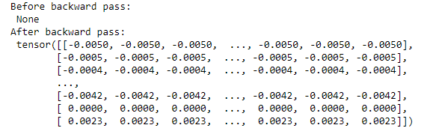
Before the backward pass, the model weights are set to default none values. Once, we call the backward() function the weights are updated.

Slide 27
It makes use of torch.optim which is a module provided by PyTorch to optimize the model, perform gradient descent and update the weights by back-propagation. Thus in each epoch (number of times we iterate over the training set), we will be seeing a gradual decrease in training loss.
【optimizer = optim.SGD(model.parameters(), lr=0.003, momentum=0.9)
time0 = time()
epochs = 15
for e in range(epochs):
running_loss = 0
for images, labels in trainloader:
# Flatten MNIST images into a 784 long vector
images = images.view(images.shape[0], -1)
# Training pass
optimizer.zero_grad()
output = model(images)
loss = criterion(output, labels)
#This is where the model learns by backpropagating
loss.backward()
#And optimizes its weights here
optimizer.step()
running_loss += loss.item()
else:
print("Epoch {} - Training loss: {}".format(e, running_loss/len(trainloader)))
print("\nTraining Time (in minutes) =",(time()-time0)/60)】

Slide 28
Step 6 — Testing & Evaluation
The model is ready, but we have to evaluate it first. I created a utility function view_classify() to show the image and class probabilities that were predicted. The code is available on GitHub.
【def view_classify(img, ps):
''' Function for viewing an image and it's predicted classes.
'''
ps = ps.data.numpy().squeeze()
fig, (ax1, ax2) = plt.subplots(figsize=(6,9), ncols=2)
ax1.imshow(img.resize_(1, 28, 28).numpy().squeeze())
ax1.axis('off')
ax2.barh(np.arange(10), ps)
ax2.set_aspect(0.1)
ax2.set_yticks(np.arange(10))
ax2.set_yticklabels(np.arange(10))
ax2.set_title('Class Probability')
ax2.set_xlim(0, 1.1)
plt.tight_layout() 】

Slide 29
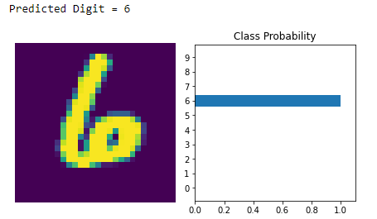
Passing an image to the trained model from the validation set that we created earlier, it can see how the model works.
【images, labels = next(iter(valloader))
img = images[1].view(1, 784)
with torch.no_grad():
logps = model(img)
ps = torch.exp(logps)
probab = list(ps.numpy()[0])
print("Predicted Digit =", probab.index(max(probab)))
view_classify(img.view(1, 28, 28), ps)】

Slide 30

Now we iterate through the validation set using a for loop and calculate the total number of correct predictions. This is how we can calculate the accuracy.
We got over 97.2% accuracy. That’s something to celebrate. The reason we got such a high accuracy was that our data-set was clean, had a variety of well-shuffled images and a large number of them. This made our model well prepared to recognize a large number of unseen digits.
【correct_count, all_count = 0, 0 for images,labels in valloader: for i in range(len(labels)): img = images[i].view(1, 784) with torch.no_grad(): logps = model(img) ps = torch.exp(logps) probab = list(ps.numpy()[0]) pred_label = probab.index(max(probab)) true_label = labels.numpy()[i] if(true_label == pred_label): correct_count += 1 all_count += 1 print("Number Of Images Tested =", all_count) print("\nModel Accuracy =", (correct_count/all_count))】

Slide 31
1. https://pytorch.org/
2. https://towardsdatascience.com/handwritten-digit-mnist-pytorch-977b5338e627

